Slide 1

Greater Vancouver Regional Science Fair
April 9-11TH, 2015

Slide 2
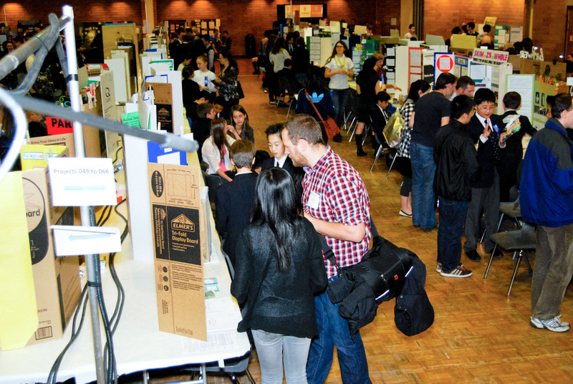
What are science fairs about?
Sharing your interest for a science project
Networking
Communication skills
Scientific method
... an amazing time and great friendships!

Slide 3
Stages of science fairs
Classroom/School fairs
Districts/Local fairs
Regional fairs (GVRSF)
National (Canada-Wide Science Fair)
Fredericton, NB– May 2014
International fairs (Taiwan, Intel ISEF, ESI...)

Slide 4
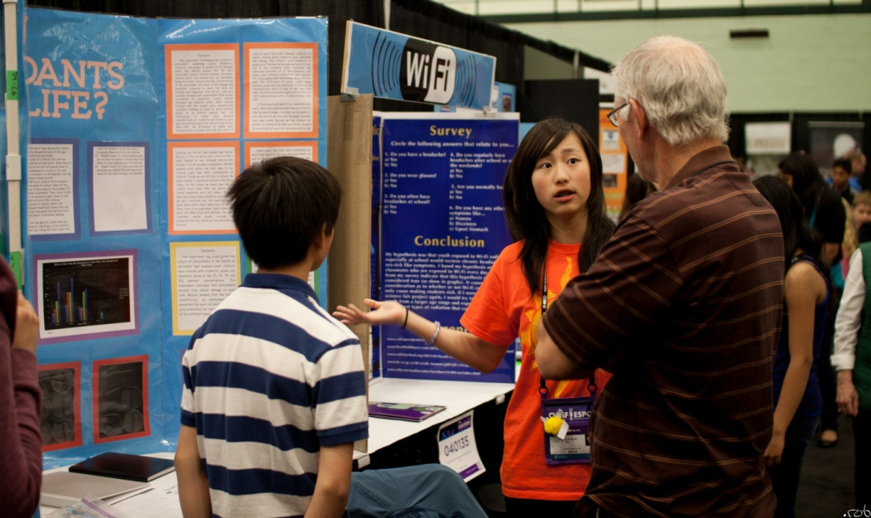
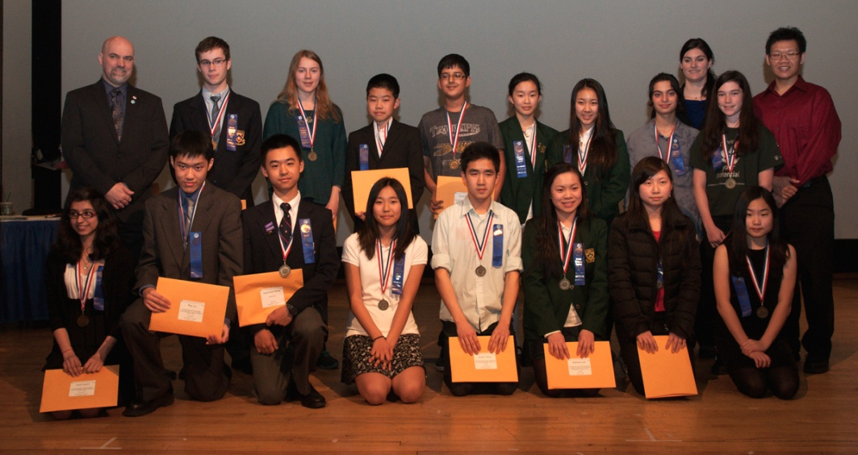
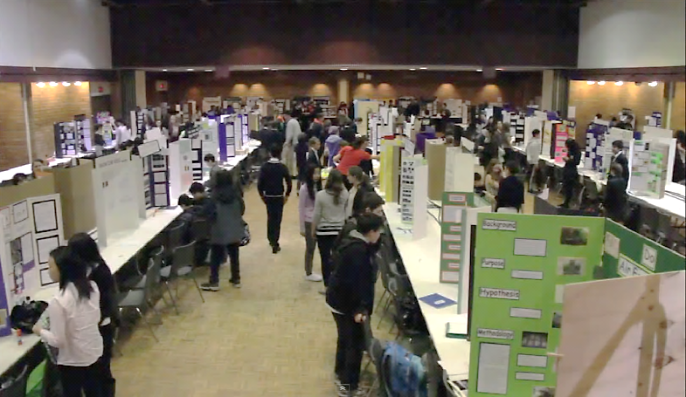
Greater Vancouver Regional Science Fair
April 9-11th, 2015
University of British Columbia
Grade 7 to 12
Up to 250 projects!

Slide 5
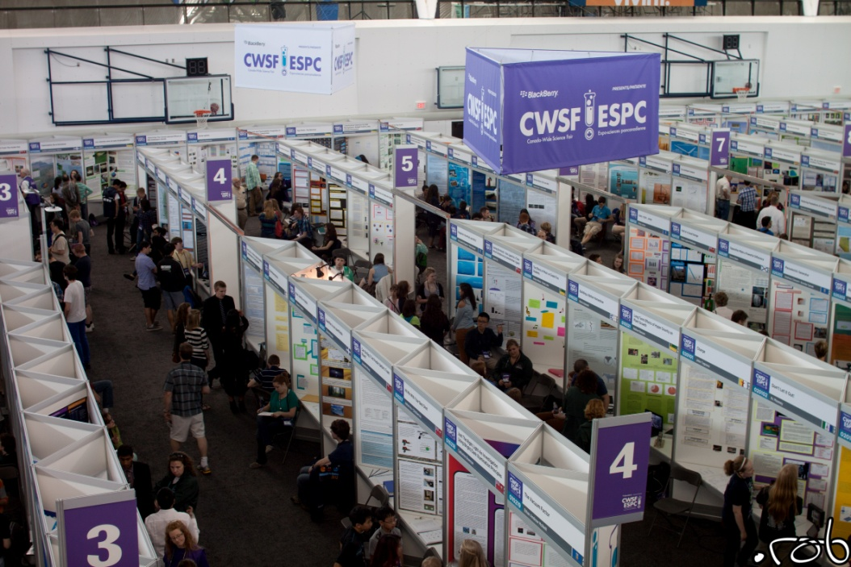
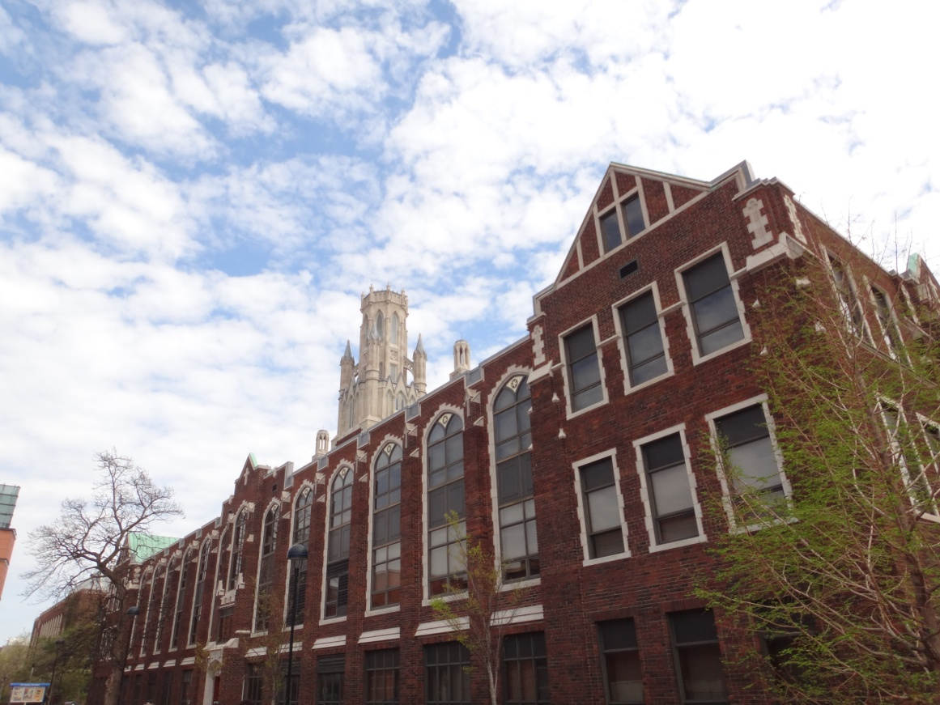
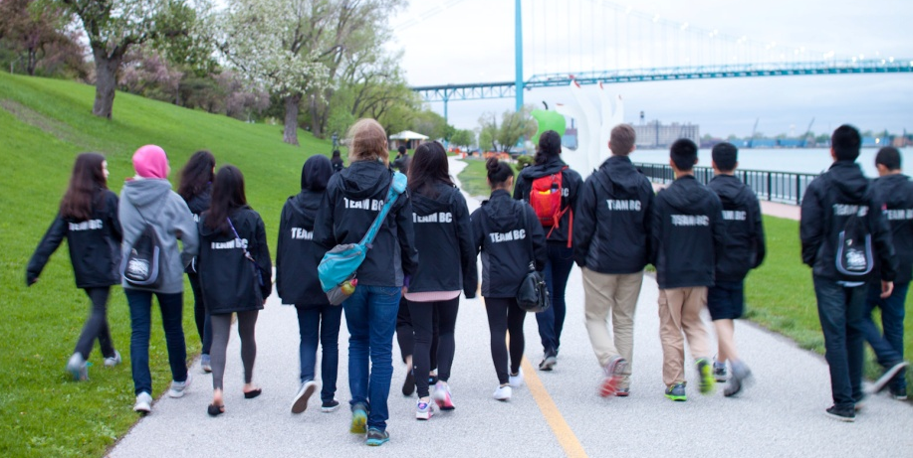
Canada-Wide Science Fair
May 10-16th, 2015
Fredericton, NB
18 finalists from GVRSF

Slide 6
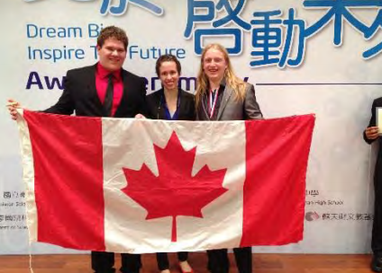
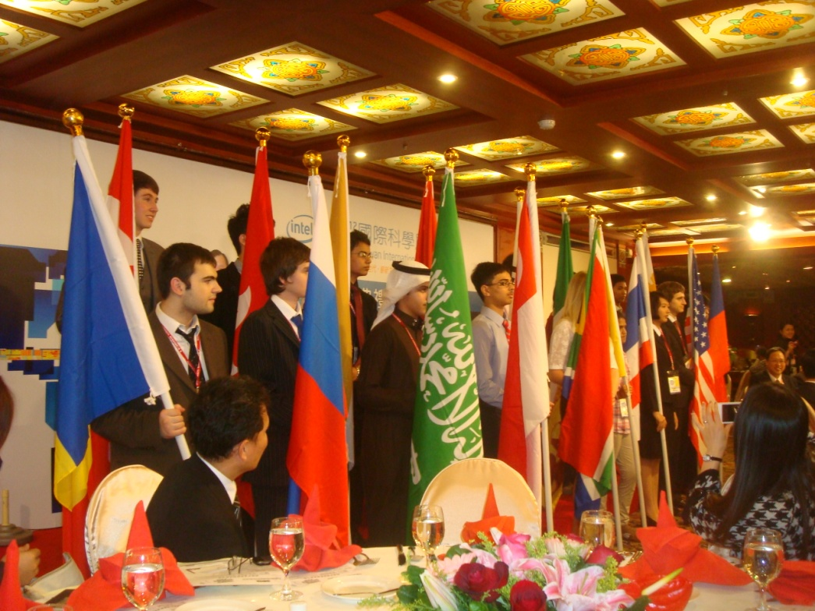
International Science Fair - Taiwan
February 4-10th, 2015
Taipei, Taiwan
2 finalists from Canada/BC

Slide 7
Types of science projects
Experiment: Undertake an investigation to test a scientific hypothesis by the experimental method. At least one independent variable is manipulated; other variables are controlled.
Innovation: Develop and evaluate new devices, models, theorems, physical theories, techniques, or methods in technology, engineering, computing, natural science, or social science.
Study: Analysis of, and possibly collections of, data using accepted methodologies from the natural, social, biological, or health sciences. Includes studies involving human subjects, biology field studies, data mining, observation and pattern recognition in physical and/or sociobehavioural data.

Slide 8
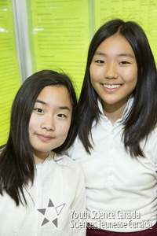
Types of science projects - Experiment
Antimicrobial Properties in Evergreen Tree Leaves
Trees are used mostly for their wood, but do they have medical properties? Inspired by Canadian indigenous people, this experiment was constructed to investigate if evergreen tree leaves have antimicrobial properties that can inhibit the growth of bacteria. This project leads to creating new, natural antibiotics that can kill bacteria, treat diseases as well as infections.

Slide 9
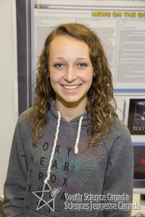
Types of science projects - Innovation
S.A.F.E. The purpose of the project was to create a program using an app called Tasker that could lock down dangerous and distracting interactions on a cell phone, while still providing necessary communications when a vehicle is in motion. When tested, the program that was created was successful in locking down the screen, therefore minimizing the dangerous and distracting interactions.

Slide 10
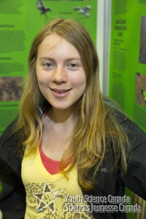
Types of science projects - Study
Island Invaders This project is a five-year ecological study of a 3.3km² area of Keats Island, BC. Data on populations of approximately 300 species of plant and animal was collected to determine distributions and relative abundance of the species. Using this information, an Invasive Species Management Plan was created to assess the potential impacts of invasive species on the island, and outline ways to reduce their impact.

Slide 11
Judging criteria
- visual display
- oral presentation
- background research
- logbook

Slide 12
Judging process and awards
Scientific thought (50%): The judges will evaluate the scientific thought in the design, the procedures and the analysis of the experiments, data and/or innovation. New, original experimental research will get marked on a higher level than projects that duplicate existing technology.
Creativity (33%): The judges will evaluate if the project shows a novel approach and use creativity in its design. Did the student think outside of the box to answer their research question or develop a new prototype, or did limited imagination was put in the project?
Communication (17%): Communication is evaluated based on four components: the visual display, the oral presentation, the project report with background research and the logbook. It is important to note that the project report is not mandatory at the regional level (like at the GVRSF). The display, report and logbook should be logical, self-explanatory, complete, and reflect the student’s scientific skill. The oral presentation will be evaluated based on the student’s enthusiasm, ability to effectively communicate findings and answer questions.

Slide 13
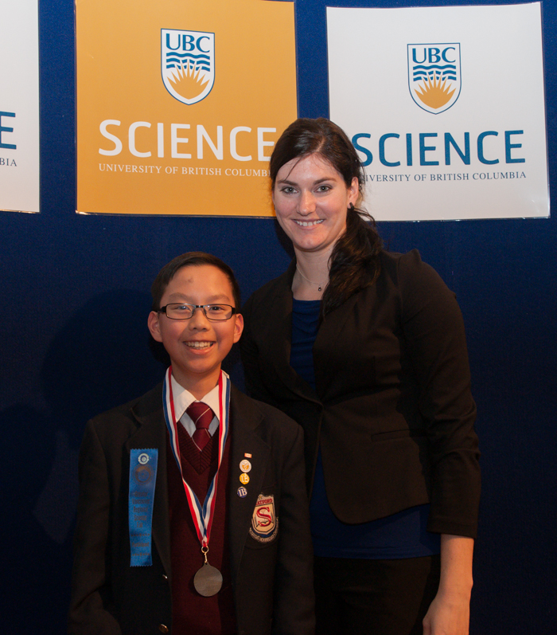
Judging process and awards
Divisional awards (gold, silver, and bronze) and Honourable mentions.
Medals are given out based on a students’ overall ranking within their age group (junior, intermediate, or senior)
Top-ranking projects will be selected to attend the Canada-Wide Science Fair in May.
Special awards
Students can self-nominate for certain special awards when they register.

Slide 14
Tips : how to get started?
What are YOU curious about?
Look around you – which problematic could benefit from the results of your project?
Search further than Wikipedia!
Mentorship
Science Fair Alumni Mentorship Program (SFF BC)
Teachers, university professors, etc.
Avoid last minute…

Slide 15
Want to live the science fair experience?
Read our 2015 Information Booklet available on our website
Contact us for projects using human participants or animals subjects (follow our ethics guidelines)
Register before March 10th, 2015!

Slide 16
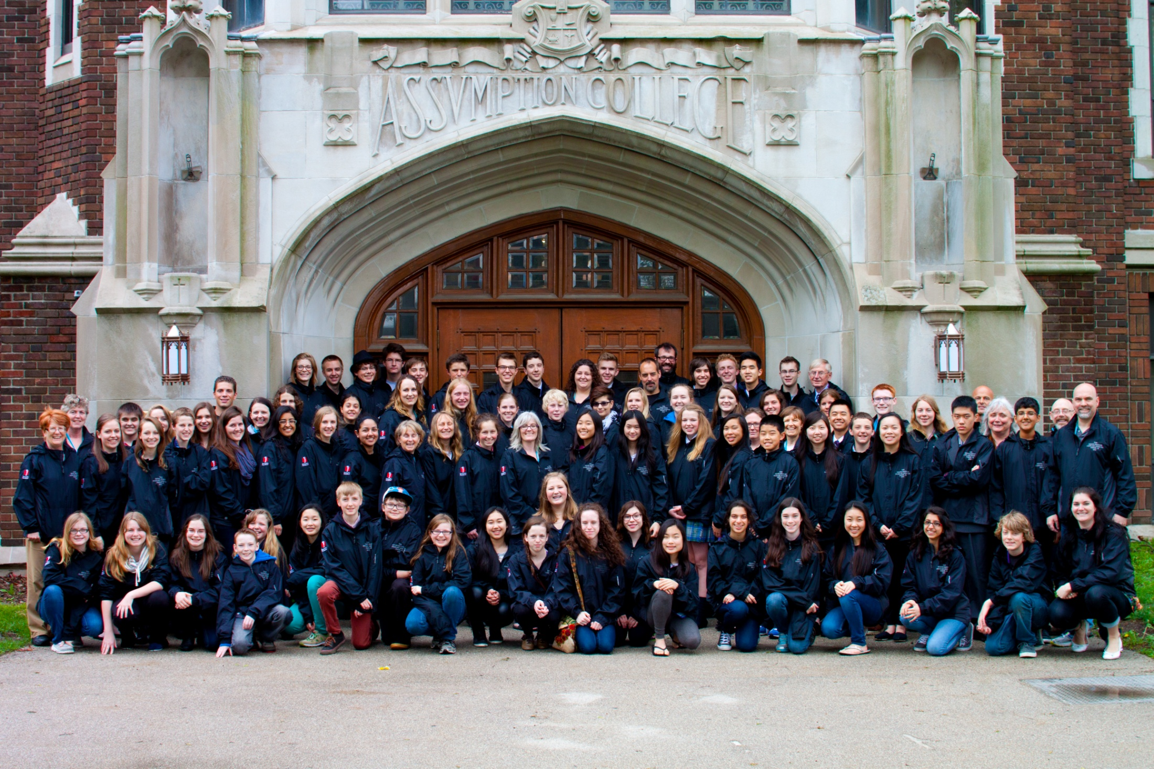
It’s not what you win – it’s what you become.

Slide 17
THANK YOU!
http://www.gvrsf.ca
http://www.sciencefairs.ca/ (Mentorship, resources)
http://www.cwsf.youthscience.ca/ (Resources)
Greater Vancouver Regional Science Fair 2015

