Slide 1

Science Fairs 101 Arooj Hayat, Kate Morley, Kit Doan, Madeleine Guenette
Hillcrest Middle School, Nov-04-2016
Greater Vancouver Regional Science Fair Committee
Notes:
30 sec

Slide 2
Outline
Intro to science fairs
Possible project types
Idea brainstorm and validation
Ethics in Science Fair
Experimental set-up (experiment or innovation)
Collecting and analyzing data
Project presentation and judging
Resources
GOAL today
Resources for later
Notes:
30 sec

Slide 3
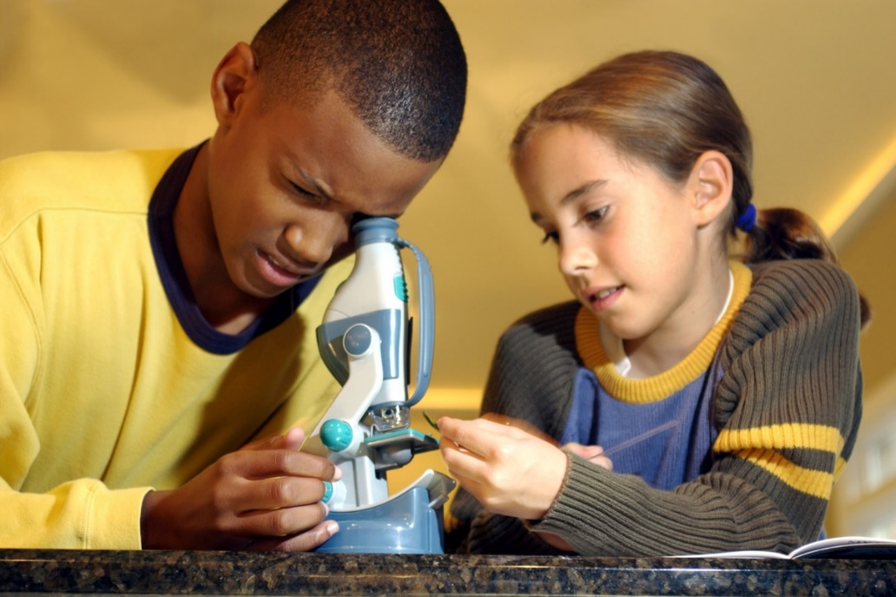
What is a Science Fair Project?
Find something you are curious about
Come up with an explanation (hypothesis)
Plan an experiment to test your theory
Check if the results match your theory
Share results with your friends, teacher, and the public!
Some projects can really help improve people’s lives!
Choose something that is important to YOU.
Notes:
1 min (give a very quick overview, and say that you will go over it in more detail ahead)

Slide 4
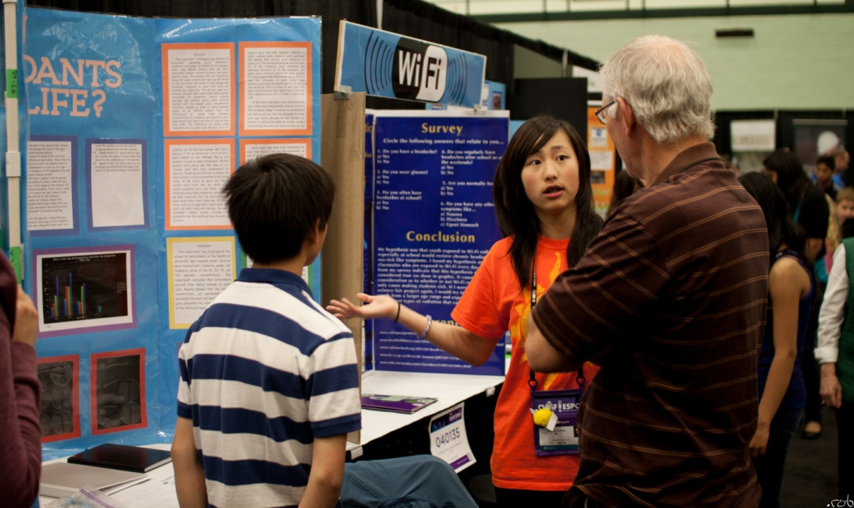
What is a Science Fair?
Meeting of curious and enthusiastic students, like YOU
You all become scientists who share their results with the public
Judges will evaluate the quality of your research
Competitive Judging for Grades 7-12
Different project types (ahead)
Judging and awards at each level:
School → Regional → Canada-Wide
Notes:
1 min
Hillcrest Middle School has students in Grades 6 to 8. So emphasize that competitive judging starts from grade 7 at the Regional level
This year the Canada-Wide will be held in Regina, Saskatchewan

Slide 5




Types of science fair projects
Experiment
Innovation
Study
Actively test a hypothesis by manipulating one variable and controlling others
Design and test new devices, models, theories, or method in any science discipline
Analyze collections of data using accepted methods from the sciences
Notes:
5 min; take time to describe examples and invite questions if any
(examples provided by Anne-Marie)
After describing these project types, remind students that: yes, saving the world ideas are great, but to really commit and be interested in a project, the students should choose a topic that is important to them. You can ask them to look around, in their daily lives, at issues they see and how they could help resolve them.
Experimentation: 1) Elizabeth is a competitive swimmer. She was often told that buying the more expensive swimsuit would help her swim a bit faster because of the aerodynamics principles. She wanted to test for herself to see if this was true. She built a prototype machine that consisted of a mannequin wearing a swimsuit that would be pulled across a pool with a controlled, specific force. She did multiple trials with various brands of swimsuits and did not find any significant difference between the times for the trials of each swimsuit. She now buys the cheaper, regular brands instead of the very expensive ones!
2) Max is a soccer player and he realizes that his teammates found practicing head shots more difficult when the weather was cool. He built a prototype set up in his basement that allowed him to measure the force of impact of a soccer ball on a mannequin head depending on the temperature of the soccer ball (room temperature vs cooled in fridge or freezer). His results showed that the measured impact was greater when the balls were cold - from now on their coach keeps the soccer balls in the mini-van to keep them away from the cold until they are ready to practice to reduce the impact!
Innovation: 1) Duncan commute by bike and was worried about the possibility of a front impact accident on his bike. He designed a prototype for an alternative bike frame that would lower the danger of an front impact. He tested his prototype with a mannequin multiple times and showed how his design makes it safe to bike and reduce serious injuries when a front impact accident happens.
2) Anna had a friend who lives in a country where they didn't always have electricity. To help her out, she designed a flashlight that use the power generated by the heat of the hand while someone holds and use the device. It was a simple design that she did at home, but that can potentially have high impact in helping accessibility to electricity and resources!
Study:
1) Else is passionate with birds. She spent hours in the forest near her home documenting the various bird species in the area. She documented over 300 species and was able to determine their distribution. She also developed a Invasive Species Management Plan to lower the impact of certain invasive species in the area.
****The general idea to remember is that, yes, saving the world ideas are great, but to really commit and be interested in a project, the students should choose a topic that is important to them. You can ask them to look around, in their daily lives, at issues they see and how they could help resolve them.

Slide 6

Let’s start exploring to find ideas!

Slide 7
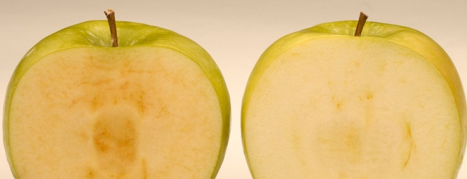
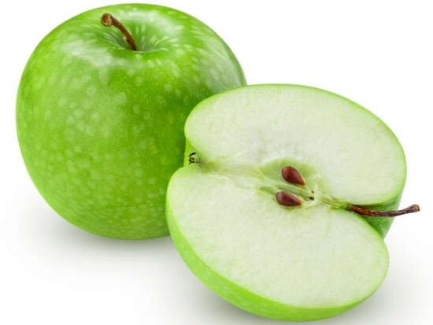
Science around you and me (1/3)
With lemon juice
Why does lemon juice prevent browning?
Are there other juices that will work too?
?!
Notes:
5 min (dependent on student engagement – limit 5 minutes)
Ask these questions and invite the students to come up with explanations…. Or better yet, more questions!
What is it about lemon juice that prevents browning?
What other juices might also work?
Would milk work?
Would orange juice work? (yes it might because it contains citric acid like lemon juice – but that’s only true if citric acid is what really prevents browning…. Etc.)
Probe the students to form some hypotheses. Don’t necessarily want answers here.

Slide 8
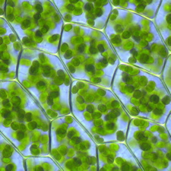
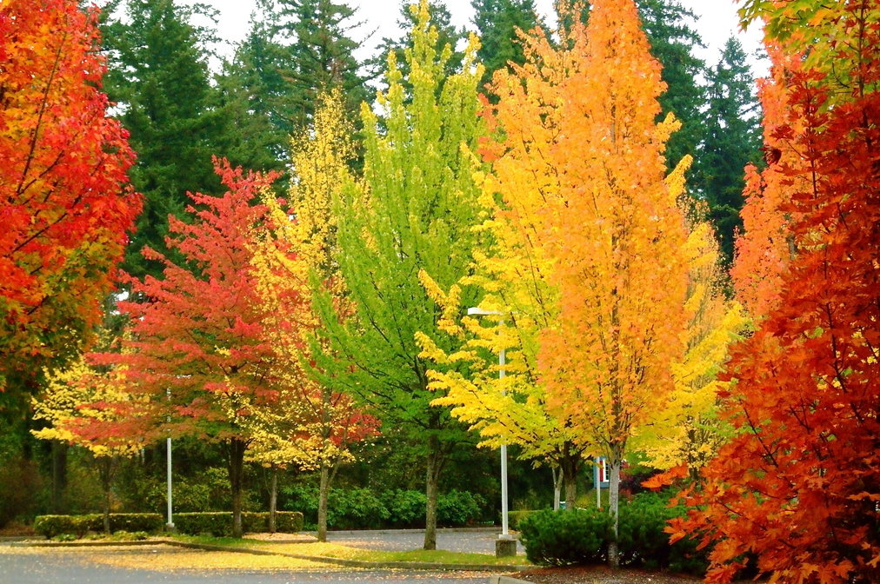
Science around you and me (2/3)
?!
Why do trees change colour?
What gives plants their green colour?
Do trees start.. or stop.. making it (or something else..) to change colour?
Notes:
5 min (dependent on student engagement – limit 5 minutes)
Why do trees change colour? …. Cold? …. Dry? ….. Lack of nutrients? ..... Toxic substances?
What gives plants their green colour? (see if they can come up with chlorophyll.. Otherwise probe a little)
What is the purpose of this green colour?
Do trees start or stop making this (chlorophyll) or something else… to change colour?

Slide 9
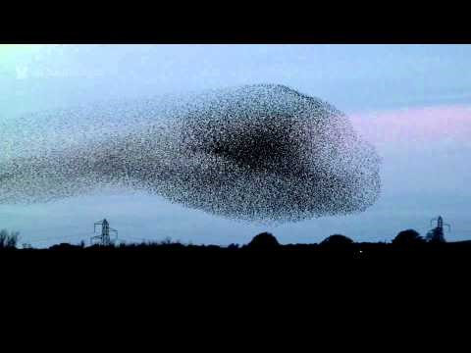
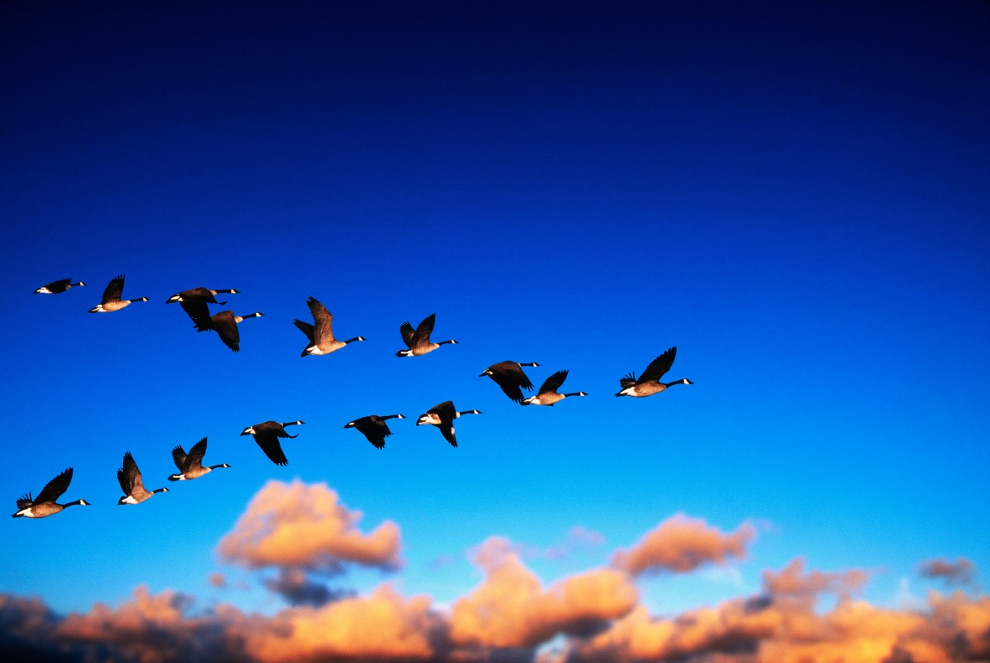
Science around you and me (3/3)
?!
How/why do birds fly in formations or “murmurations”?
Notes:
5 min (dependent on student engagement – limit 5 minutes)
Show video if possible (click on right image). If not, describe the image (a swarm of starlings flying together in clouds that keep shifting shapes)
Quick fun activity to demonstrate “transmission of information”: Telephone game
Whisper a phrase in one student’s ear, and have them whisper it around the room, one person to another, quickly. Ask the last student what the phrase was.
Was the phrase the same?
Did the phrase change?
Where did it change? (in birds, this relates to the farthest point of coherent movement, or the largest number of birds that can participate in a formation)
Why might it change?
Then ask how this relates to birds flying in formation? Have them think about this a bit and get creative.
Can the air around one bird contribute to the flight of the next bird?

Slide 10
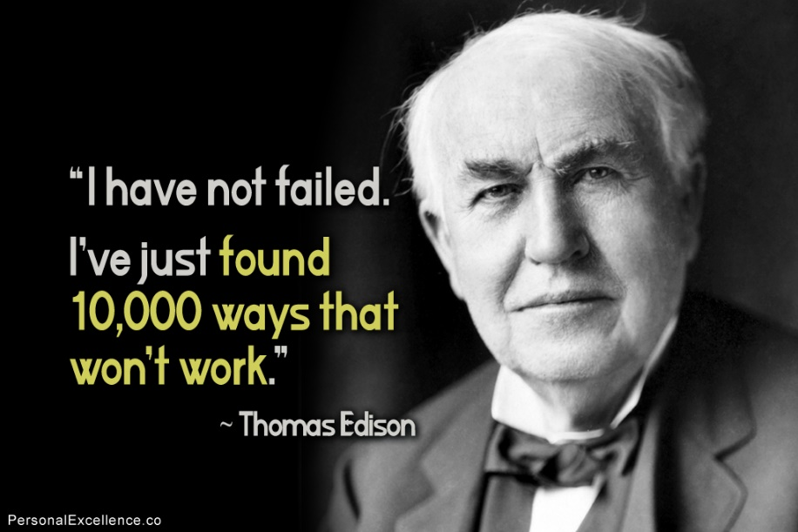
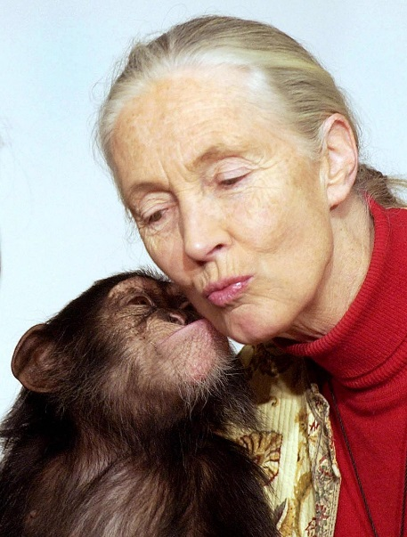
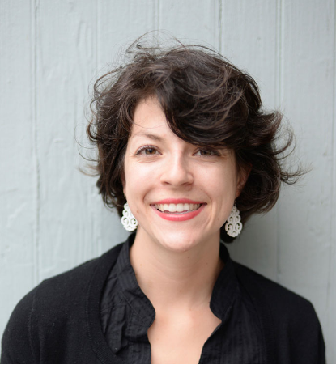
Science Champions… who asked questions just like you!
Thomas Edison
Invented practical & affordable lightbulb after trying 6000 materials
Jane Goodall
Chimpanzee behaviour studies & conservation efforts
Elika Bergelson
Language learning in babies
Notes:
1 min
Jane Goodall: observed chimpanzees’ behaviour in the wild and realized how alike they are to humans ex. in terms of social structures. She has since gone on to make significant changes in chimpanzee conservation efforts and stop illegal trafficking of chimps and their body parts
Thomas Edison: invented the first practical and affordable lightbulb…. But got there by testing more than 6000 different materials for the electric current in a bulb! He didn’t give up…. And now we all have affordable electricity!
Elika Bergelson: lesser known and young, but also a Science Champion who has won the prestigious Top 30 under 30 award for her work. She studies how babies learn language. She found that around only 6 months old, we start understanding words for foods and body parts!

Slide 11


Okay… but how do I find an idea?!
Find “WHY” and “HOW” questions
Brainstorming activity!
To have a great idea, have lots of them
– Thomas Edison
Notes:
3 min total
“Just like we thought about our Exploration question earlier, think about some things in your everyday life and what kind of WHY/HOW questions you can ask about them”
Round 1: take out a piece of paper and pencil/pen. You have 1 minute – write down as many questions as you can that pop into your head. There are NO bad questions!
Round 2: pair up with a buddy. You have 1 minute to share your questions with each other.
Round 3: You have 30 seconds to write down 2 new questions you have after chatting with your buddy

Slide 12
Lots of ideas! How to validate?!
Your top 2-3 ideas
Google Search: have others answered this?
Related new question?
Google Search your new question
Your project idea!
YES
NO
YES
NO
Notes:
1 min (Goal: now you have all these ideas. Pick your top 2-3 and explore them online. See if you can easily find answers, or if there are aspects to the question that you can help find more answers to. If you are left feeling unsatisfied with the answers… maybe that’s your project idea and you can come up with answers!)
Pick your top 2-3 ideas
Google Search: what have others done to answer this? Is there an answer already?
If YES: can you think of something that is still not answered related to your idea? (the best idea you get here would be when you’re feeling genuinely curious with questions like “why not ____?” or “how come ____ worked but _____ didn’t?”
If YES2: Google search your new question to see if anyone has done this
If NO (both situations): looks like you found your project idea!
Next step = design experiment that will help answer your question. Start simple! What are experimental models?
Before you ask for or buy resources, look at what is available to you in your classroom, at school, and at home
Maybe your first experiment won’t be exactly at the highly complex level that you had in mind, but there is a simplified question that helps provide answers to the bigger question. It is JUST as valuable!!

Slide 13
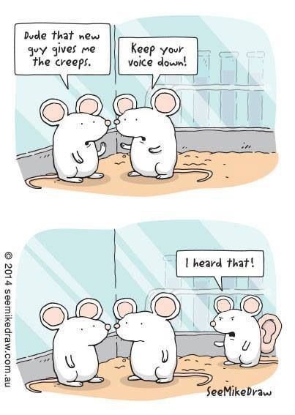
Let’s talk about Science Ethics

Slide 14
Scenario 1 (2015 abstracts) Make sure your project is safe!
“Firstly we had to boil the water and then place it carefully, into our metal pot, and place our metal pot at our workspace. Next we would sit down our participant at the table, blindfold them, and place their hands in the water.”
Problem: Dangerous for participants!
Notes:
1 min
Ask students about what is potentially wrong with the scenario

Slide 15
Scenario 2 (2015 abstracts) Make sure your project is ethical!
“Infants were randomized to 4 experimental groups…Pain was measured using the Faces-Legs-Activity-Crying-Consolability (FLACC) scale.”
Potentially dangerous to participants BUT this student sought pre-approval, which was granted after revisions. This was an excellent project!
Notes:
1 min
Ask students about what is potentially wrong with the scenario

Slide 16
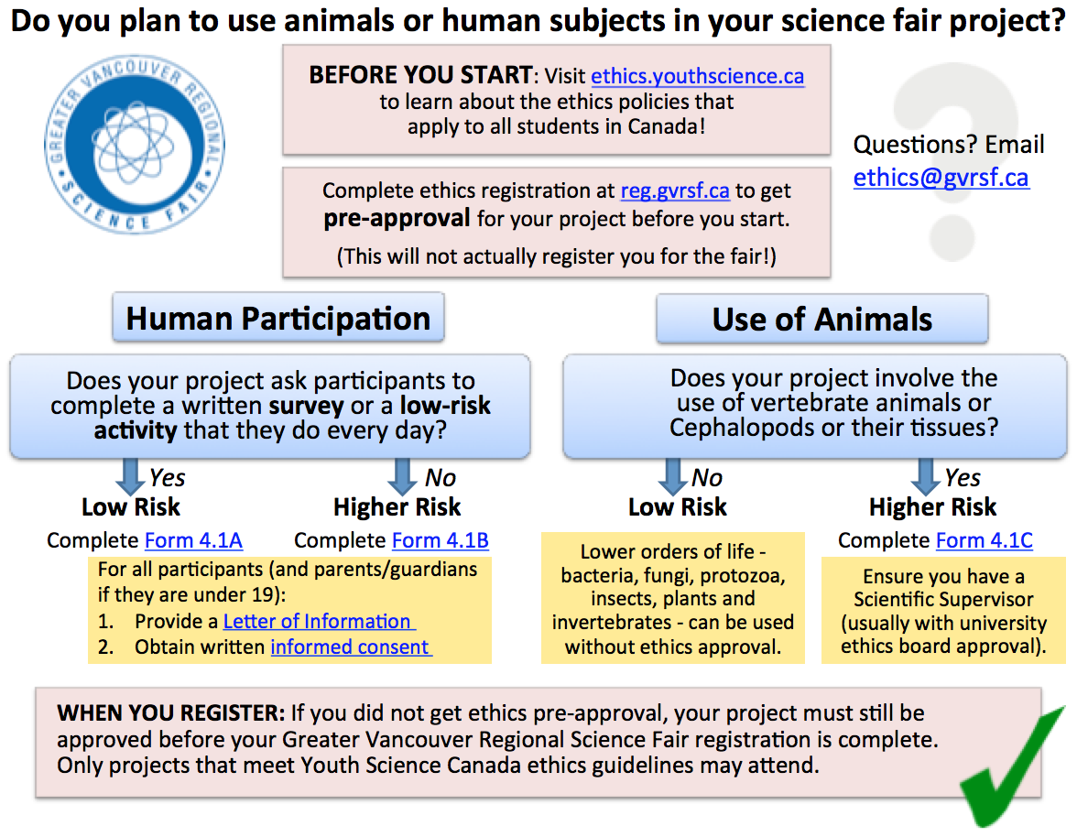
Notes:
1 min: Main points:
have students visit ethics.youthscience.ca before they finalize their idea,
Students in Grades 7 and up: complete ethics registration at reg.gvrsf.ca for pre-approval before they start (this does NOT register you for the fair, but it ensures that your project is ethical and will not get disqualified if you get to Regionals)

Slide 17
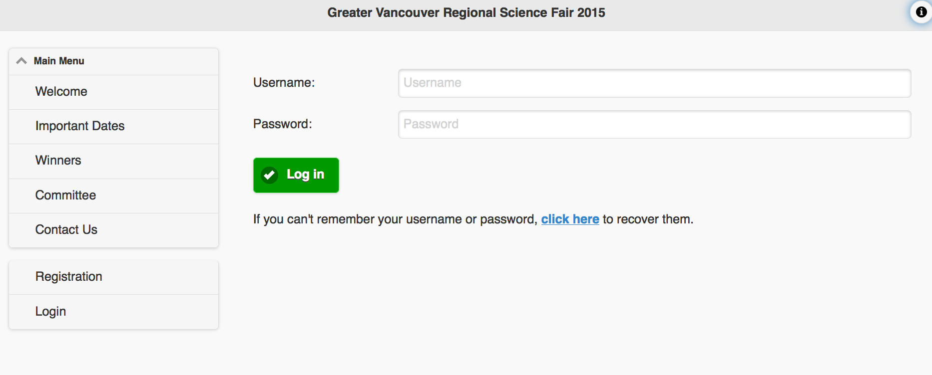
GVRSF registration system
ALL projects with human or animal subjects must have ethics pre-approval BEFORE attending the GVRSF!
This is done through the registration system.
www.reg.gvrsf.ca
Notes:
30 sec: Reminder to get ethics pre-approval before starting their projects

Slide 18
You have an idea, you had it approved Now what? EXPERIMENTAL SETUP
Topic
Research Question
Hypothesis
Tested Variables (dependent)
Controlled Variables (indepen)
Unintended Variables
Results
Analysis
Present!
Notes:
5 min
Goal of this slide: “This is a flowchart of your work for the project” Let’s take the example of plant growth experiment.
Make sure your research questions is precise. Compare: (A) How do plants grow? Vs (B) Do plants grow better with plain water or sugary water?
Make a hypothesis. Predict what the answer might be to your question. Search online for answers and any ideas other people might have about your question.
There are 3 types of variables you need to consider now:
Tested variables: this is what you are studying to answer your research question. Ex. for plant growth, you might measure the height of your plant, the number of leaves, the colour of leaves, etc.
Controlled variables: these are things that can affect your tested variable, so you want to keep them steady. Ex. for plant growth experiment, the type of water given to plants, sunlight, temperature, humidity, and time for which plants are grown will affect how much they grow. How can you control these? (allow a bit of discussion)
Unintended variables: what if someone was cutting your plants every day and you didn’t even know?! Or there was a weird fungus growing on your plants and it caused all your plants to grow in an abnormal way?! To control these kinds of events, we include positive and negative controls:
Positive control = something that should always lead to the expected outcome (ex. plant growth ALWAYS happens with just water added to soil and plant)
Negative control = something that should never lead to the expected outcome (ex. no/minimal plant growth if you don’t add any water at all)
Later when you look at your results, you can check the positive and negative controls to make sure that nothing else affected your results. If your positive control didn’t grow at all… then something else happened that you need to investigate. Was someone cutting all your plants? Did you give plants bad water? Become a detective!
4) Now you will do your experiment and get results that we can analyze them. (discussed ahead)

Slide 19
Setting up an experiment project
Repeat
as needed
(1) Research question, hypothesis & experimental design
Tested variable(s)
Controlled variables
(+) & (-) controls (control unwanted variables)
Ways to measure variable(s)
(2) Performing experiment
Keep detailed logbook
>3 trials per tested variable
Measure carefully
Notes:
2 minutes (just doing a quick summary of the key ideas in experiment set-up that were discussed in last slide. Ask students if they understand positive and negative controls), plus 3 key points:
Really take the time to consider ways to measure your variables so you can answer your question. Be creative. Ex for plant growth, should you measure stalk height? # of new leafs? Rate of stalk height change over days or hours? Leafs’ size? – measure as many variables as you reasonably can, and then look for patterns later when you are analyzing results
When you are performing the experiment, measure carefully, have at least 3 trials for each tested variable (ex. at least 3 plants that get just water, 3 plants that get water and sugar, and 3 plants that don’t get any water), and keep a detailed logbook for every day that you work on your project. Record all your observations and data.
After doing the experiment, maybe you will find that you need to repeat the experiment because your positive and negative controls didn’t work the way you expected. Or maybe you have a new and related question you want to answer.

Slide 20
Setting up an innovation project
Identify problem
Can you improve?
Current solutions?
Design solution
Test design
(2) Performing experiment
Repeat as needed
Measure carefully
>3 trials per tested variable
Keep detailed logbook
Remember:
Notes:
2 minutes
Goal of this slide: maybe you want to invent something instead! If so, the testing part of your design will be done exactly like an experiment.
Make sure you have a specific research question when you are testing your invention. Ask: How fast can my invention work (ex. a robot car)? Can my robot car follow a path on the floor? Can my pulley lift at least 5 times heavier weights than I can? Etc.

Slide 21
You did the experiment. You have results! Now we… Analyze data
Check out for tips: http://www.sciencebuddies.org/science-fair-projects/project_data_analysis.shtml
Is your data set complete?
Calculate averages where appropriate (average results from >3 trials for each variable)
Calculate standard deviations for each average to see how much your numbers vary from the average
Graph data in Excel
Can you see any interesting patterns in your data?
Notes:
2 minutes
(****If you have time at this point (need about 20min, which includes 5min for Q/A), continue going over next few Analysis slides 22-27. Otherwise, cover as much as you can, skip to discussion and presentation, and say that students will get the slides through their teacher when they get to the analysis stage of their projects)
Data set complete? Do you have at least 3 trials (or 3 attempts) for each variable? Ex. if testing effect of lemon juice on apple skin, did you check on at least 3 different apples?
Calculate averages and standard deviations (next slide)
Interesting patterns: look for whether some variables are behaving in an unexpected way, or maybe they are behaving exactly as you expected.

Slide 22
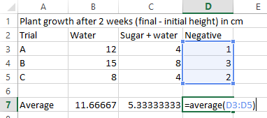
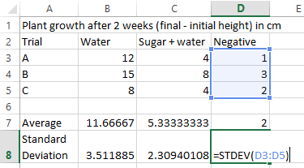
You measured plant height of 9 plants Results & Basic Analysis
Average
= (Sum of all data) / (# of data points)
Ex. (1+3+2)/3
Standard Deviation
How different is your data than the average?
Notes:
2 min
Just a quick lesson on how to use Excel to calculate Average and Standard Deviation
Quickly define the meaning of Average (“a number that represents the total data, rather than listing every single number in a category”)
Meaning of standard deviation = “tells us how far does the data set vary away from the calculated average”

Slide 23
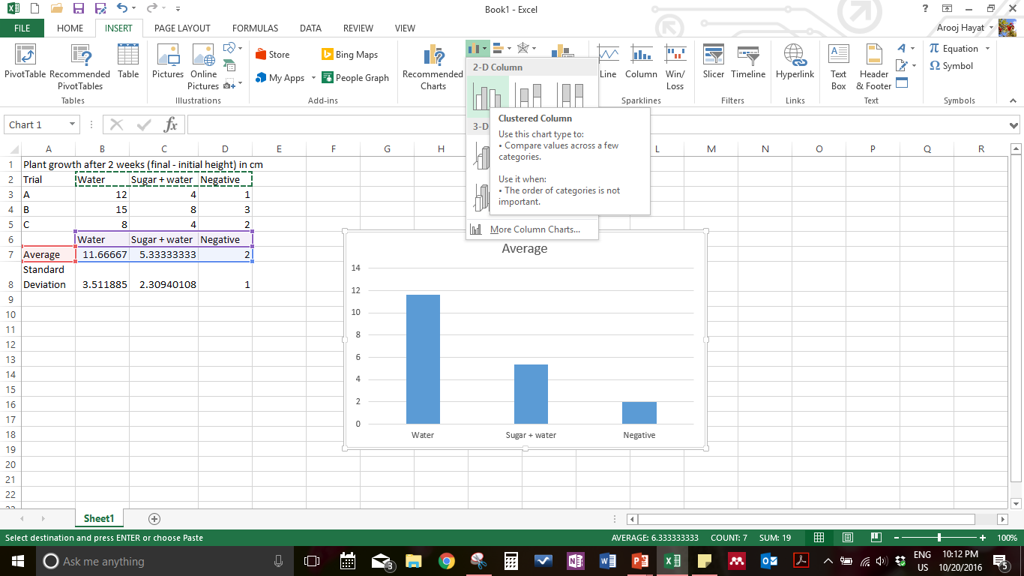
Making graphs
What does this graph need?
Descriptive chart title
Axes labels
Error bars
Font size
Notes:
2 min
What does this graph need?
Descriptive chart title (plant type, effect being measured (sugar), duration of experiment (2 weeks))
Axes need labels (y-axis: plant height (cm) x-axis: Treatment)
Error bars to show standard deviation, i.e. showing how much the data could vary away from the average (Ex. explain that an error bar for “Water” would start 3.5 points above the bar, and end 3.5 points below the bar)

Slide 24
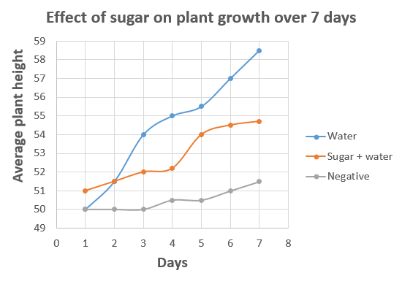
Graphs: When do we use a… bar graph VS line graph?
TOTAL growth
Growth OVER TIME
Effect of sugar on average plant growth after 2 weeks
Plant height (cm)
Water
Sugar + Water
Negative
Notes:
2 min
Showing total growth of plants that each got different treatments
You measured total height of each plant after 7 days of treatment, and you took an average of plant heights in each treatment group
Showing growth of one plant over time
You measured height of 1 plant every day for 7 days
OR you measured height of each plant (3+) every day for 7 days
Also consider: should these points be connected? Or should you draw a line of best fit?
Points should be connected if are absolutely sure that between each measurement, your plants grew at exactly the speed as it appears on the graph
Points should NOT be connected if they are discontinuous. Ex. on each day you actually measured a different plant, not the same one!! (never do this)

Slide 25
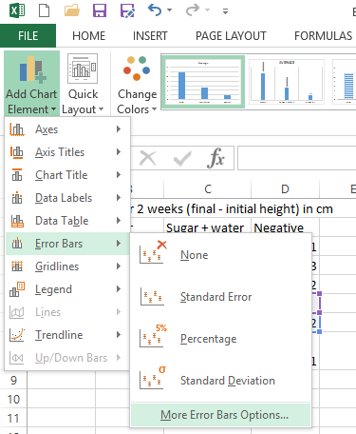
What are error bars? How to insert them?
Error bars
Visually represent how much your data varies from the average
Do NOT
use this!!
Use this!!
Then select cells with your calculated standard deviation
Notes:
30 sec

Slide 26
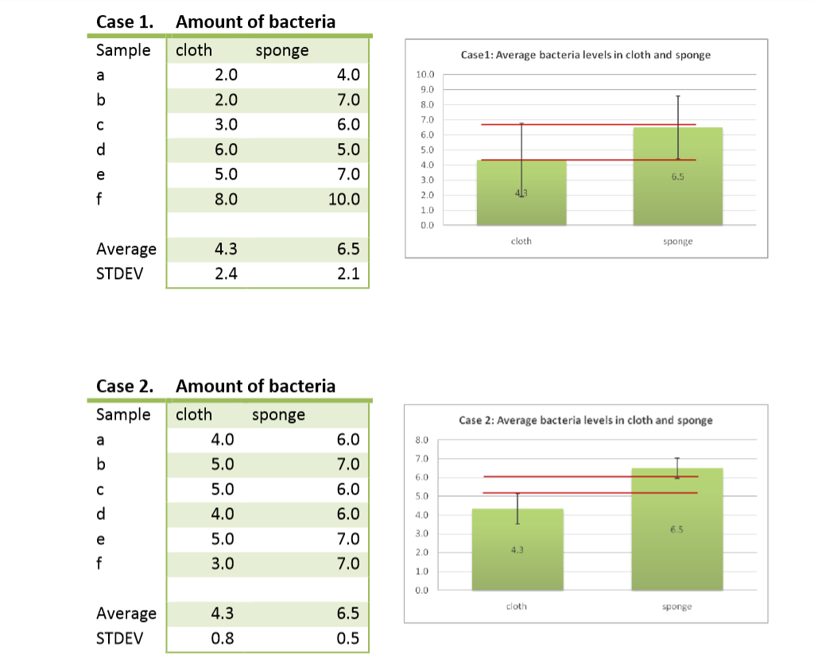


The value of error bars based on standard deviation
Error bars overlap!
No real difference
Better to repeat experiment
Errors bars don’t overlap
Real data
Notes:
30 sec
If your error bars overlap, which were created using standard deviation, then your results don’t really have a difference. They are basically the same data, and your tested variables had no different effects

Slide 27
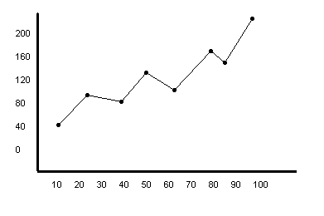
What is a GOOD graph?
What is this graph missing?
Axes not labelled
No title
Wasted space on right side
Can points be connected? (depends on data)
Notes:
1 min
Cover this slide if you don’t have time for any of the other data analysis slides

Slide 28
Detailed Discussion in Project Report
Include error bars – do your error bars overlap?
Compare your results with current research (reference back to your background information and research)
What was your “special sauce” (what made your project original)?
How have you added to the scientific body of knowledge? How can your experiment have an impact to society?
What are some limitations to your project and how would you address them in future studies?
Notes:
2 min

Slide 29


Share your presentation expertly Plan out with your partner!
Public & friends
Judging
Short explanation
2-5 min
Deeper explanation
5-10 min
Remember:
Not about a good show,
But about good science!
Notes:
2 min

Slide 30
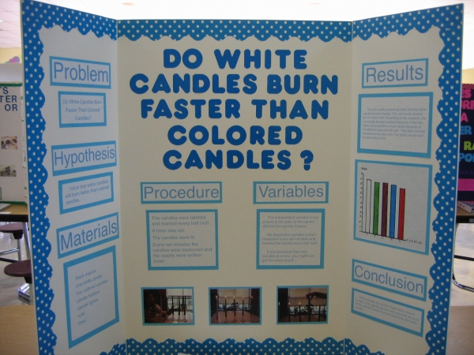
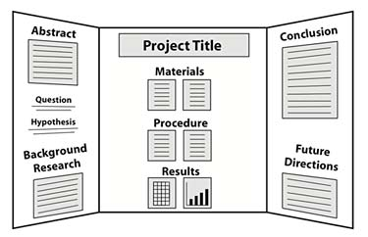
Your presentation backboard – design it logically so it helps you during judging
Sciencebuddies.org
Notes:
2 min
Parts of the backboard:
Project title, your name, your partner’s name, your grade, & your school name
Abstract: a 250 words summary of your entire project
Question & Hypothesis
Background research: summarize what you found online related to your question, use bullet points
Materials: list the materials you used for your experiment, add pictures if you want! (ex. plant growth: plants, type of soil, type of sugar, measuring stick, water, etc.)
Procedure: how did you collect data? How did you set up your experiment? Describe your controlled variables, tested variables, etc
Results: share your observations, and your graphs. Make sure each graph is labeled and titled properly
Conclusion: what are some conclusions that you can make based on your data? Does sugar increase or decrease plant growth?
Future directions: if you did the experiment again, what would you improve? What are some new related questions you can ask? What impact can your experiment have on society, other people, the world, etc?
What is this project display board missing? What can be improved?

Slide 31
Just so you know for 2017… Science Fair Mentorship
The Science Fair Alumni Mentorship Program (AMP) is an initiative run by volunteer science fair alumni which helps students in grades 7-12 find the resources they need to investigate scientific questions of interest to them. Based on an initial project proposal, AMP matches students with one or two mentors: a former Canada-Wide Science Fair participant and a university or industry expert.
For more information and to apply, visit the http://www.sciencefairs.ca/Science-Fairs/Mentorship.aspx
Mentorship help for Students YSC’s SMARTs program - http://smarts.youthscience.ca/ CIHR Mentorship Program - http://www.cihr-irsc.gc.ca/synapse/
Notes:
30 sec (say information will be provided to teacher, but there are opportunities available for students if they choose to do a science fair project again next year)

Slide 32
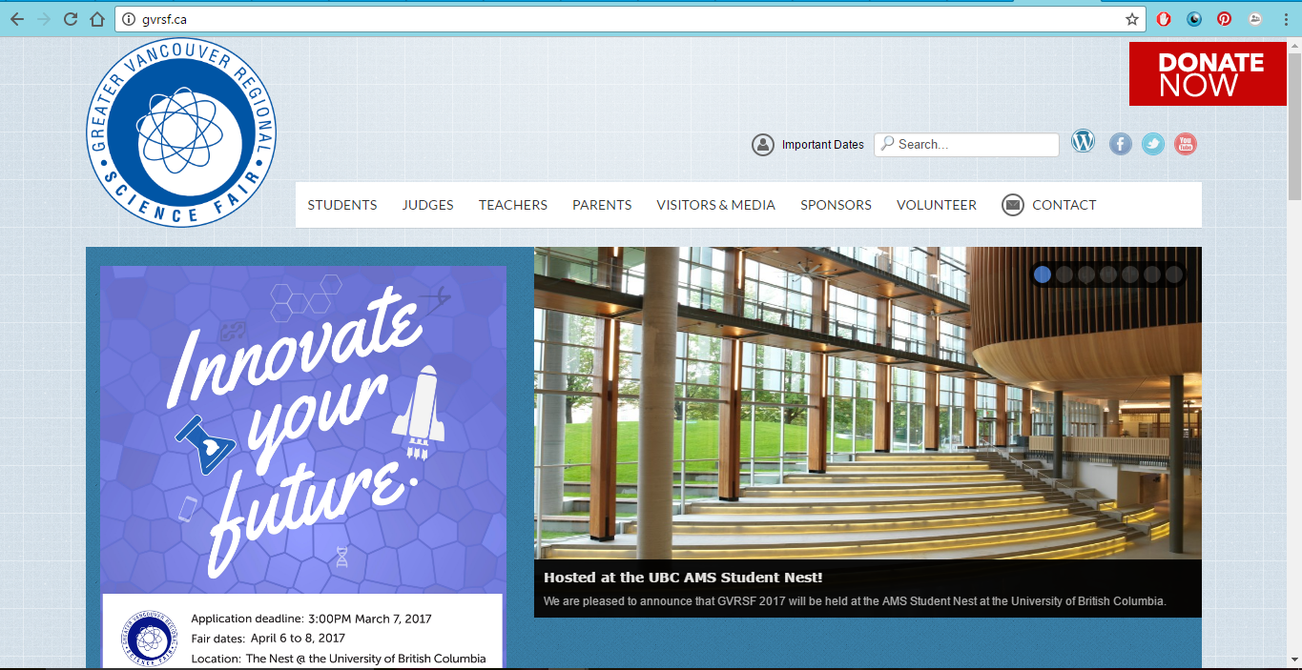
Go to the Greater Vancouver Regional Science Fair Website
For registration and more resources, visit: www.gvrsf.ca
Notes:
30 sec

Slide 33

Questions?

